Slide 1
What is Data Mining?
DAMA-NCR
Tuesday, November 13, 2001
Laura Squier
Technical Consultant
lsquier@spss.com

Slide 2
Agenda
What Data Mining IS and IS NOT
Steps in the Data Mining Process
  CRISP-DM
  Explanation of Models
  Examples of Data Mining Applications
Questions

Slide 3
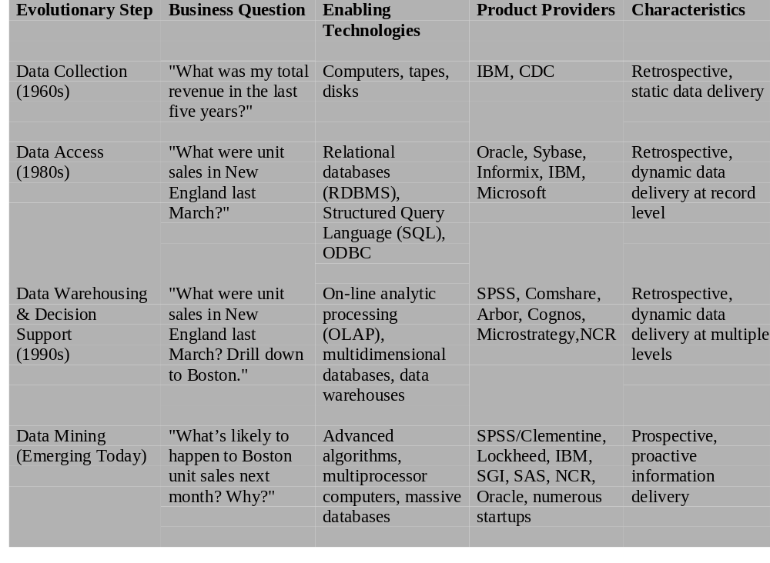
The Evolution of Data Analysis

Slide 4
Results of Data Mining Include:
Forecasting what may happen in the future
Classifying people or things into groups by recognizing patterns
Clustering people or things into groups based on their attributes
Associating what events are likely to occur together
Sequencing what events are likely to lead to later events

Slide 5

Data mining is not
Brute-force crunching of bulk data
“Blind” application of algorithms
Going to find relationships where none exist
Presenting data in different ways
A database intensive task
A difficult to understand technology requiring an advanced degree in computer science

Slide 6

Data Mining Is
A hot buzzword for a class of techniques that find patterns in data
A user-centric, interactive process which leverages analysis technologies and computing power
A group of techniques that find relationships that have not previously been discovered
Not reliant on an existing database
A relatively easy task that requires knowledge of the business problem/subject matter expertise

Slide 7
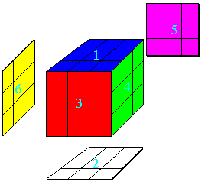
Data Mining versus OLAP
OLAP - On-line Analytical Processing
  Provides you with a very good view of what is happening, but can not predict what will happen in the future or why it is happening

Slide 8
Data Mining Versus Statistical Analysis
Data Mining
  Originally developed to act as expert systems to solve problems
  Less interested in the mechanics of the technique
  If it makes sense then let’s use it
  Does not require assumptions to be made about data
  Can find patterns in very large amounts of data
  Requires understanding of data and business problem
Data Analysis
  Tests for statistical correctness of models
    Are statistical assumptions of models correct?
      Eg Is the R-Square good?
  Hypothesis testing
    Is the relationship significant?
      Use a t-test to validate significance
  Tends to rely on sampling
  Techniques are not optimised for large amounts of data
  Requires strong statistical skills

Slide 9
Examples of What People are Doing with Data Mining:
Fraud/Non-Compliance Anomaly detection
  Isolate the factors that lead to fraud, waste and abuse
  Target auditing and investigative efforts more effectively
Credit/Risk Scoring
Intrusion detection
Parts failure prediction
Recruiting/Attracting customers
Maximizing profitability (cross selling, identifying profitable customers)
Service Delivery and Customer Retention
  Build profiles of customers likely to use which services
Web Mining

Slide 10

How Can We Do Data Mining?
By Utilizing the CRISP-DM Methodology
  a standard process
  existing data
  software technologies
  situational expertise

Slide 11
Why Should There be a Standard Process?
Framework for recording experience
  Allows projects to be replicated
Aid to project planning and management
“Comfort factor” for new adopters
  Demonstrates maturity of Data Mining
  Reduces dependency on “stars”
The data mining process must be reliable and repeatable by people with little data mining background.

Slide 12
Process Standardization
CRISP-DM:
CRoss Industry Standard Process for Data Mining
Initiative launched Sept.1996
SPSS/ISL, NCR, Daimler-Benz, OHRA
Funding from European commission
Over 200 members of the CRISP-DM SIG worldwide
  DM Vendors - SPSS, NCR, IBM, SAS, SGI, Data Distilleries, Syllogic, Magnify, ..
  System Suppliers / consultants - Cap Gemini, ICL Retail, Deloitte & Touche, …
  End Users - BT, ABB, Lloyds Bank, AirTouch, Experian, ...

Slide 13

CRISP-DM
Non-proprietary
Application/Industry neutral
Tool neutral
Focus on business issues
  As well as technical analysis
Framework for guidance
Experience base
  Templates for Analysis

Slide 14
The
CRISP-DM
Process Model

Slide 15
Why CRISP-DM?
The data mining process must be reliable and repeatable by people with little data mining skills
CRISP-DM provides a uniform framework for
  guidelines
  experience documentation
CRISP-DM is flexible to account for differences
  Different business/agency problems
  Different data

Slide 16
Phases and Tasks
Business
Understanding
Data
Understanding
Data
Preparation
Modeling
Evaluation
Deployment
Determine
Business Objectives
Background
Business Objectives
Business Success
Criteria
Situation Assessment
Inventory of Resources
Requirements,
Assumptions, and
Constraints
Risks and Contingencies
Terminology
Costs and Benefits
Determine
Data Mining Goal
Data Mining Goals
Data Mining Success
Criteria
Produce Project Plan
Project Plan
Initial Asessment of
Tools and Techniques
Collect Initial Data
Initial Data Collection
Report
Describe Data
Data Description Report
Explore Data
Data Exploration Report
Verify Data Quality
Data Quality Report
Data Set
Data Set Description
Select Data
Rationale for Inclusion /
Exclusion
Clean Data
Data Cleaning Report
Construct Data
Derived Attributes
Generated Records
Integrate Data
Merged Data
Format Data
Reformatted Data
Select Modeling
Technique
Modeling Technique
Modeling Assumptions
Generate Test Design
Test Design
Build Model
Parameter Settings
Models
Model Description
Assess Model
Model Assessment
Revised Parameter
Settings
Evaluate Results
Assessment of Data
Mining Results w.r.t.
Business Success
Criteria
Approved Models
Review Process
Review of Process
Determine Next Steps
List of Possible Actions
Decision
Plan Deployment
Deployment Plan
Plan Monitoring and
Maintenance
Monitoring and
Maintenance Plan
Produce Final Report
Final Report
Final Presentation
Review Project
Experience
Documentation

Slide 17
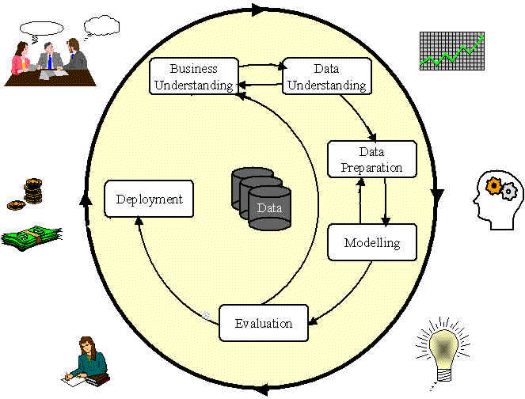
Phases in the DM Process:
CRISP-DM

Slide 18
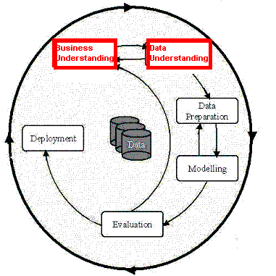
Phases in the DM Process (1 & 2)
Business Understanding:
  Statement of Business Objective
  Statement of Data Mining objective
  Statement of Success Criteria
Data Understanding
  Explore the data and verify the quality
  Find outliers

Slide 19
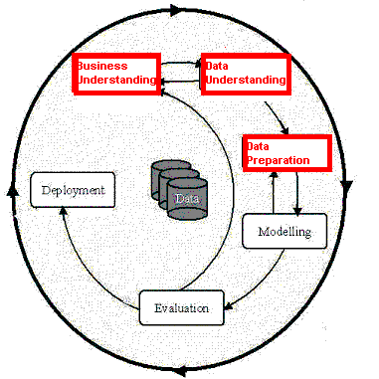
Phases in the DM Process (3)
Data preparation:
  Takes usually over 90% of our time
    Collection
    Assessment
    Consolidation and Cleaning
      table links, aggregation level, missing values, etc
    Data selection
      active role in ignoring non-contributory data?
      outliers?
      Use of samples
      visualization tools
    Transformations - create new variables

Slide 20
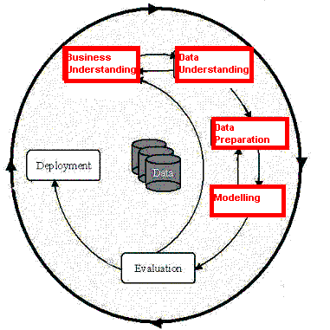
Phases in the DM Process (4)
Model building
  Selection of the modeling techniques is based upon the data mining objective
  Modeling is an iterative process - different for supervised and unsupervised learning
    May model for either description or prediction

Slide 21
Types of Models
Prediction Models for Predicting and Classifying
  Regression algorithms (predict numeric outcome): neural networks, rule induction, CART (OLS regression, GLM)
  Classification algorithm predict symbolic outcome): CHAID, C5.0 (discriminant analysis, logistic regression)
Descriptive Models for Grouping and Finding Associations
  Clustering/Grouping algorithms: K-means, Kohonen
  Association algorithms: apriori, GRI

Slide 22
Neural Network
Input layer
Hidden layer
Output

Slide 23
Neural Networks
Description
  Difficult interpretation
  Tends to ‘overfit’ the data
  Extensive amount of training time
  A lot of data preparation
  Works with all data types

Slide 24
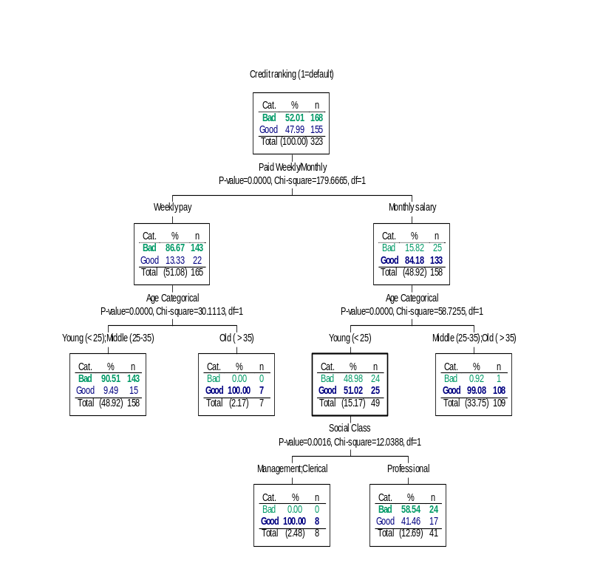
Rule Induction
Description
  Produces decision trees:
    income < $40K
      job > 5 yrs then good risk
      job < 5 yrs then bad risk
    income > $40K
      high debt then bad risk
      low debt then good risk
  Or Rule Sets:
    Rule #1 for good risk:
      if income > $40K
      if low debt
    Rule #2 for good risk:
      if income < $40K
      if job > 5 years

Slide 25
Rule Induction
Description
Intuitive output
Handles all forms of numeric data, as well as non-numeric (symbolic) data
C5 Algorithm a special case of rule induction
Target variable must be symbolic

Slide 26
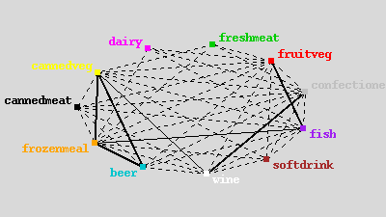
Apriori
Description
Seeks association rules in dataset
‘Market basket’ analysis
Sequence discovery

Slide 27
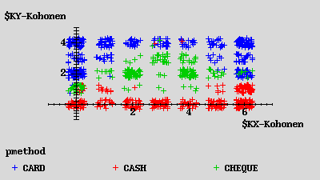
Kohonen Network
Description
unsupervised
seeks to describe dataset in terms of natural clusters of cases

Slide 28
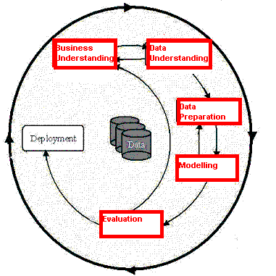
Phases in the DM Process (5)
Model Evaluation
  Evaluation of model: how well it performed on test data
  Methods and criteria depend on model type:
    e.g., coincidence matrix with classification models, mean error rate with regression models
  Interpretation of model: important or not, easy or hard depends on algorithm

Slide 29
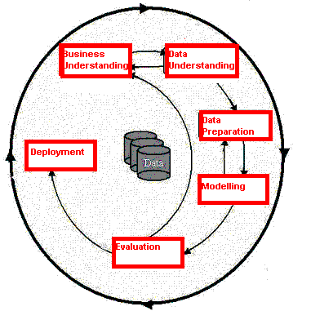
Phases in the DM Process (6)
Deployment
  Determine how the results need to be utilized
  Who needs to use them?
  How often do they need to be used
Deploy Data Mining results by:
  Scoring a database
  Utilizing results as business rules
  interactive scoring on-line

Slide 30
Specific Data Mining Applications:

Slide 31

What data mining has done for...
The US Internal Revenue Service
needed to improve customer service and...
Scheduled its workforce
to provide faster, more accurate answers to questions.
Notes:
The US Internal Revenue Service is using data mining to improve customer service.
[Click] By analyzing incoming requests for help and information, the IRS hopes to schedule its workforce to provide faster, more accurate answers to questions.

Slide 32

What data mining has done for...
The US Drug Enforcement Agency needed to be more effective in their drug “busts” and
analyzed suspects’ cell phone usage to focus investigations.
Notes:
The US DFAS needs to search through 2.5 million financial transactions that may indicate inaccurate charges. Instead of relying on tips to point out fraud, the DFAS is mining the data to identify suspicious transactions.
[Click] Using Clementine, the agency examined credit card transactions and was able to identify purchases that did not match past patterns. Using this information, DFAS could focus investigations, finding fraud more costs effectively.

Slide 33

What data mining has done for...
HSBC need to cross-sell more
effectively by identifying profiles
that would be interested in higher
yielding investments and...
Reduced direct mail costs by 30% while garnering 95% of the campaign’s revenue.
Notes:
Retail banking is a highly competitive business. In addition to competition from other banks, banks also see intense competition from financial services companies of all kinds, from stockbrokers to mortgage companies.
With so many organizations working the same customer base, the value of customer retention is greater than ever before. As a result, HSBC Bank USA looks to enticing existing customers to "roll over" maturing products, or on cross-selling new ones.
[Click] Using SPSS products, HSBC found that it could reduce direct mail costs by 30% while still bringing in 95% of the campaign’s revenue. Because HSBC is sending out fewer mail pieces, customers are likely to be more loyal because they don’t receive junk mail from the bank.

Slide 34
Final Comments
Data Mining can be utilized in any organization that needs to find patterns or relationships in their data.
By using the CRISP-DM methodology, analysts can have a reasonable level of assurance that their Data Mining efforts will render useful, repeatable, and valid results.

Slide 35

Questions?

Slide 36
























Ignatius Hospital

